Slide 1
SRS Workshop
Bangalore, May 2016

Slide 2
Der Social Reporting Standard (SRS)
Agenda
Welcome note and round of introduction
Input session
Background and objective of Social Reporting Standard
Result and results chain
Documentation of results within Social Reporting Standard (practical exercise)
Working Session I: The social problem and your solution
Working Session II: Social results
Concluding session and feedback

Slide 3
Der Social Reporting Standard (SRS)
Why a Social Reporting Standard?
Challenge 1: Unreasonable Expectations
Impact measurement hype
Impact oriented funders and investors expect quantiative and comparable impact measures, preferably monetized (SROI).
Insufficient data
Many Social Entrepreneurs cannot quantify their impact (for financial or con-ceptual reasons) and tend to report output data instead.
?
Reasonable
and pragmatic compromise

Slide 4

Der Social Reporting Standard (SRS)
Why a Social Reporting Standard?
Challenge 2: Waste of Time
Each funder has different formats and standards for proposals and reporting.
Social Entrepreneurs spend an unreasonable share of their time to write these redundant documents.
Could there be one standardized document for all these purposes?

Slide 5
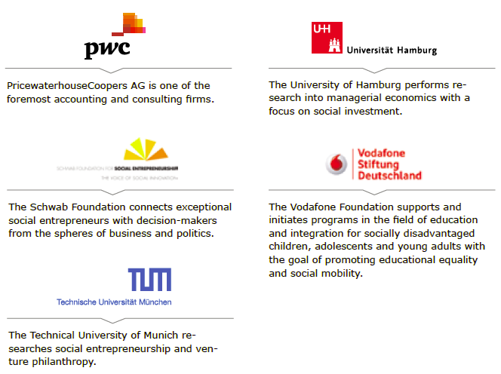
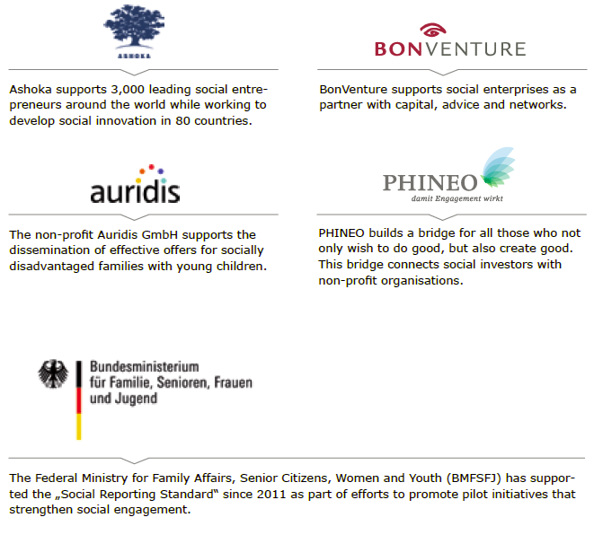
Der Social Reporting Standard (SRS)
Initiators

Slide 6


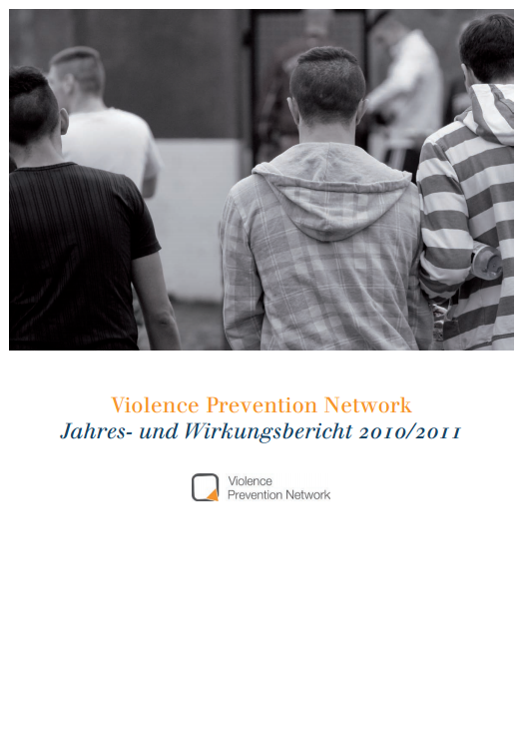

Der Social Reporting Standard (SRS)
The SRS
Guidelines
Report Template
Report

Slide 7
Der Social Reporting Standard (SRS)
What are results?
Results are changes…
… in the lives of target groups which occur in consequence of an intervention (activity, measure, project, etc.).
Initial situation
Intervention
Results
Causal
cause-effect relationship

Slide 8
Der Social Reporting Standard (SRS)
Simple results chain (I-O-O-I)
Variety of concepts and definitions
Effect
The use of definitions and approaches in both theory and practice are very different – and sometimes contradictory.
Outcome
Impact
Benefit
Quality
Result
Outcome
The SRS is based on the
Input-Output-Outcome-Impact Typology (IOOI).

Slide 9
Der Social Reporting Standard (SRS)
The I-O-O-I Typology
Results are changes in consequence of outputs
Input
Output
Outcome
Impact
Resources:
Financial means
Equipment
Time
Knowledge
Competences
Structural-, human-, relational capital
Achievements:
Immediately visible performance
-> several accomplished activities, e.g. number of publications
Results:
Changes in the lives of the target groups:
Knowledge
Behavior
…
Results:
Outcome minus what would have happened without the activities

Slide 10
Der Social Reporting Standard (SRS)
Simple IOOI results chain
Example: Qualification of unemployed youth
Social Challenge:
Only 20 percent of all young people without a school leaving certificate accomplish to take up an apprenticeship right after dropping out of school.
Input
Output
Outcome
Impact
resources:
Financial resources
Employees and volunteers
Cooperation with other organizations working in vocational integration
Equipment (offices, etc…)
achievements:
Application training
Qualifying trainings
Individual coaching
results:
Acquisition of relevant competences and knowledge
Building up of confidence
results:
Acquisition of relevant competences and knowledge - as shown in a scientific study

Slide 11
Der Social Reporting Standard (SRS)
There are many kinds of results
e.g.:
short-, medium- and long term
direct und indirect
intended and unintended
expected and unexpected
positive and negative
temporary and permanent
subjectively experienced and objectively demonstrated
system changing and not system changing
Results
Results
Results
Results
Results

Slide 12
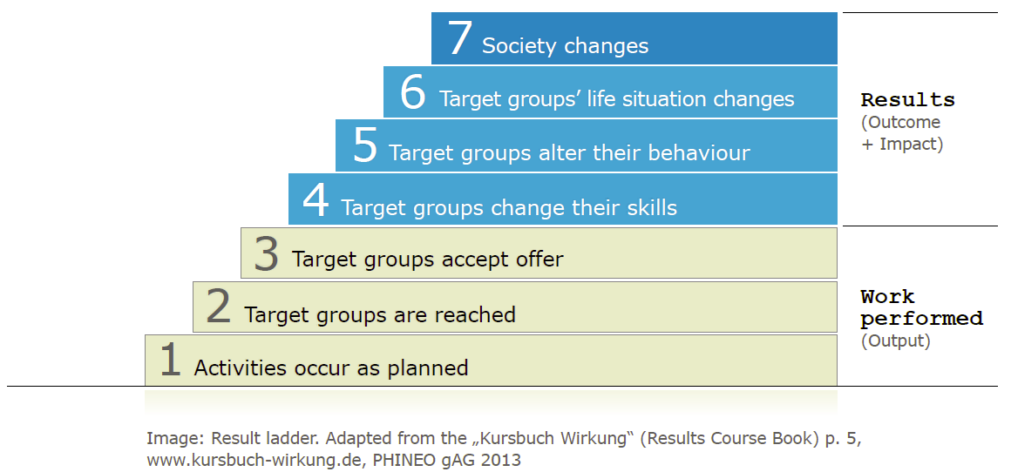
Der Social Reporting Standard (SRS)
When do we talk about results?

Slide 13
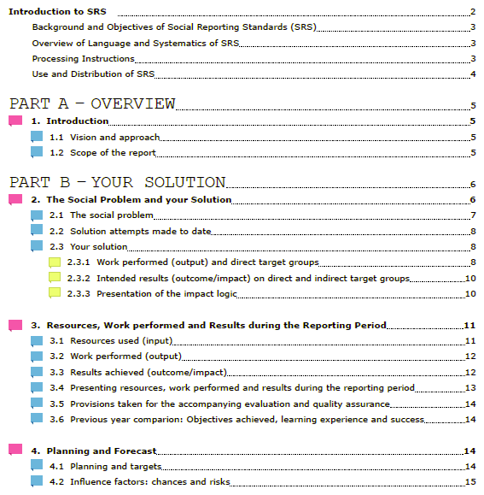
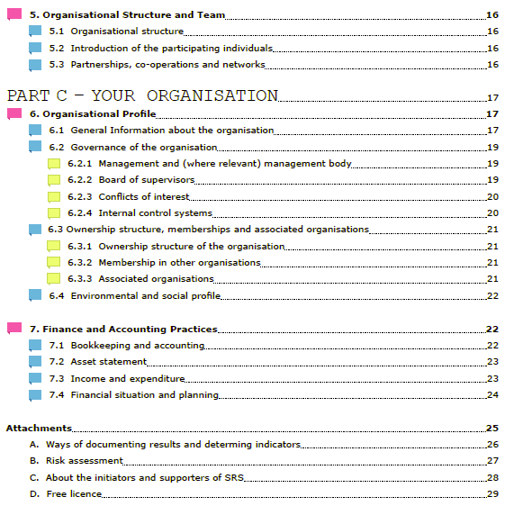
Der Social Reporting Standard (SRS)
The SRS embeds the results chain in 7 standardized sections that give a comprehensive account of the organization.

Slide 14
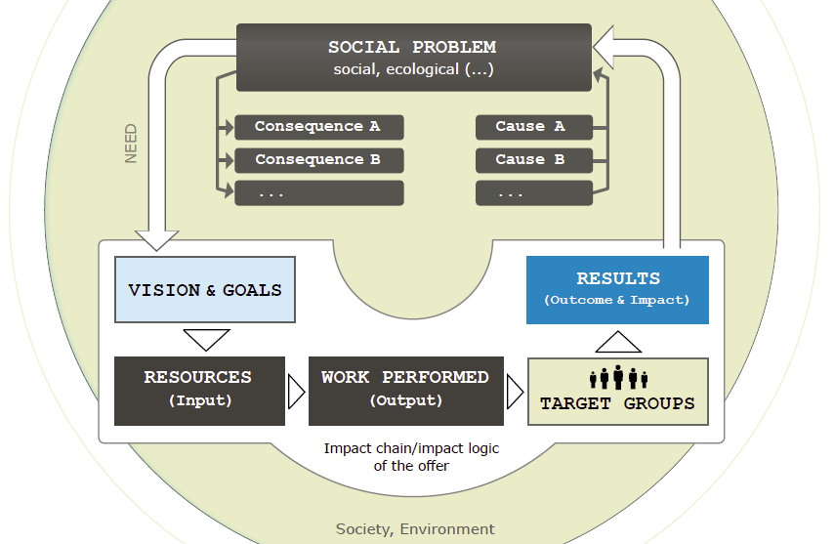
Der Social Reporting Standard (SRS)
The Circuit of Results - how all pieces belong together

Slide 15
Der Social Reporting Standard (SRS)
Each section of the SRS refers to one of these components, and some of them are treated twice – for good reasons.
2.1
1.1
2.3.2
3.3
3.1
2.3.1
3.2
2.1

Slide 16
Der Social Reporting Standard (SRS)
The SRS can also be used to report on multiple offers or organizations.
Part A
- Overview
Part B
- Your Solution
Part C
- Your Organization
Organisation
OFFER
OFFER 1
Organisation
OFFER 2
Organisation 1
OFFER
Organisation 2

Slide 17
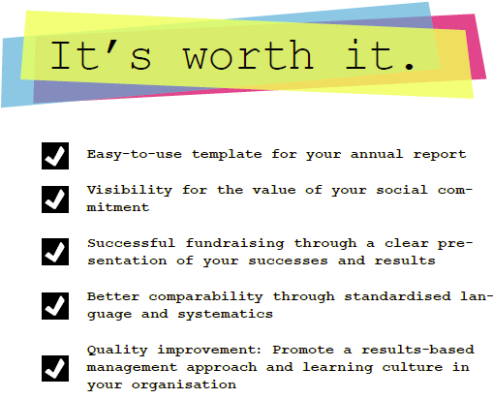
Der Social Reporting Standard (SRS

Slide 18


Der Social Reporting Standard (SRS)
The advantages of result-oriented reporting
ATTRACTING SUPPORT
INTERNAL: CEO, supervisory board, employees, volunteers …
Effective impact documentation
Evoking interest and motivation
EXTERNAL: Sponsor/client: politics and administration, foundations, public, beneficiaries,…
Result orientation
LEARNING AND IMPROVING
Die Wirkung einzelner Angebote der Organisation verstehen und verbessern
INTERNAL: Shared learning and failure culture
Internal Controlling
Decision Finding
EXTERNAL: Improving effectiveness and quality of portfolio

Slide 19
Der Social Reporting Standard (SRS)
What the SRS is and what it is NOT.
The SRS...
The SRS is NOT...
... offers guidelines for impact-oriented reporting.
... a guideline for impact measurement.
... is a standard for comprehensive reporting (incl. Organizational structure and finance).
... focused on quantitative measures.
... is the lowest common denominator for a large number of funders and what they need to know
... specific to certain topics or certain types of organizations.
... focusses on the impact chain/impact logic.
... a judgement about the quality of the activities.
... creates transparency.
... Is an open project.

Slide 20
Der Social Reporting Standard (SRS)
Agenda
Welcome note and round of introduction
Input session
Background and objective of Social Reporting Standard
Result and results chain
Documentation of results within Social Reporting Standard (practical exercise)
Working Session I: The social problem and your solution
Working Session II: Social results
Concluding session and feedback

Slide 21
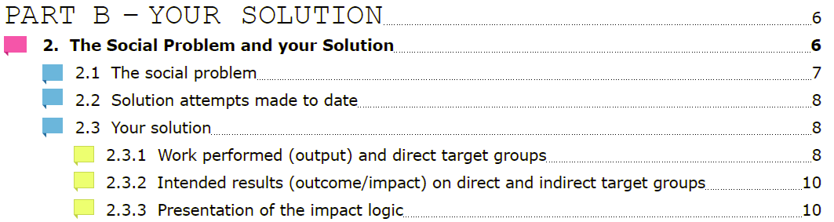
Der Social Reporting Standard (SRS)
Working Session I: The social problem and your solution

Slide 22
Der Social Reporting Standard (SRS)
Social Problem and Vision
2.1
1.1

Slide 23
Der Social Reporting Standard (SRS)
Social problem
Which specific social problem is supposed to be solved?
What is the current social situation? How did this situation change in the past and how will the situation develop in the future, in case no efforts are made (consequences)?
Who is affected by the problem? What are the needs of those affected by the problem? Why is a change of the current situation important for those affected by the problem? (needs)
Which causes lead to the problem?

Slide 24
Der Social Reporting Standard (SRS)
Vision
What is your long term vision (~ expected overall result) that you focus on with your solution?
Which (ideal) state of society are you aiming for?
What does the world look like in 5-20 years if you are successful? Which long term goals do you want to reach?
→ long term: ca. 5-20 years

Slide 25
1) Social problem / Vision (SRS 2.1 / 1.1)
Organisation
Social problem (causes and consequences)
Vision
(expected overall result)

Slide 26
Der Social Reporting Standard (SRS)
Target Groups and intended Results
2.3.2
2.1

Slide 27
Der Social Reporting Standard (SRS)
Your solution - Target Groups
Describe the target group that directly benefits from your work performance:
Who is in your target group? Who isn‘t?
Specific group of children, youngsters, parents, teachers, …
Geographical and demographic specification, special characteristics, group size, …
In which sub-target groups can the target group be divided?
Can you identify people who benefit indirectly from your work? (secondary target group)?
Families/ Teachers of the children you work with, etc.

Slide 28
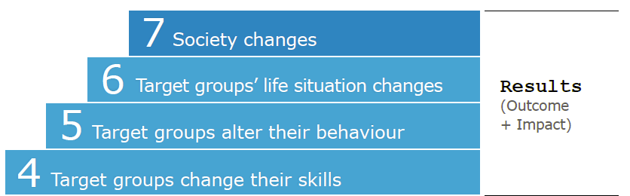
Der Social Reporting Standard (SRS)
Intended results / targets (outcomes / impacts)
Which changes (outcome / impact) do you expect as a result of your activities within your direct (and indirect) target group?

Slide 29
2) Goals / Target Group (SRS 2.3.1 / 2.3.2)
Organisation
Target Groups
(characteristics, needs)
Goals
(intended results)

Slide 30
Der Social Reporting Standard (SRS)
Your Strategy (approach to solving the problem)
2.3.1

Slide 31
Der Social Reporting Standard (SRS)
Your Strategy
At which point of the causal chain do you implement your activities?
Do they aim at preventing or curing the problem?
Which of your target groups do they involve?
Do you work
directly with individuals?
indirectly with multipliers (e.g. parental education)?
at the societal level (e.g. campaigns)?
Notes:
„

Slide 32
3) Your solution (SRS 2.3)
Organisation
Where?
When?
Preventing the problem
Solving (curing) the problem
Society
Direct living
environment
Individual

Slide 33
SRS 2.3.2 Strategie – an welcher Stelle setzen Sie an? (Ansatz)
Challenge: 15% of the 3 to 17-year old children are overweight
Causes: Limited knowledge about nutrition, low availability of sports programs
Approaches: Educational advertising, counseling, lobbying and sports programs
Wo und an welcher Stelle der Ursachenkette setzen Sie an?
Der Social Reporting Standard (SRS)
Where?
When?
Preventing the Problem
Solving (curing) the Problem
Society
Campaigns (educational advertising) promoting a healthy lifestyle
Lobbying aiming at establishing a wider range of sport programs for children suffering from nutrition-related illnesses
Direct living
environment
Education offered to parents of healthy children covering the topics nutrition and exercise
Counseling offered to parents of sick children covering the topics nutrition and exercise
Individual
Nutrition related education and sports programs offered to healthy children
Nutritional counseling and sports programs offered to parents of sick children

Slide 34
Der Social Reporting Standard (SRS)
Your „Impact Logic“ is complete now – so how did it translate into results in the reporting year?

Slide 35
Der Social Reporting Standard (SRS)
Agenda
Welcome note and round of introduction
Input session
Background and objective of Social Reporting Standard
Result and results chain
Documentation of results within Social Reporting Standard (practical exercise)
Working Session I: The social problem and your solution
Working Session II: Social results
Concluding session and feedback

Slide 36
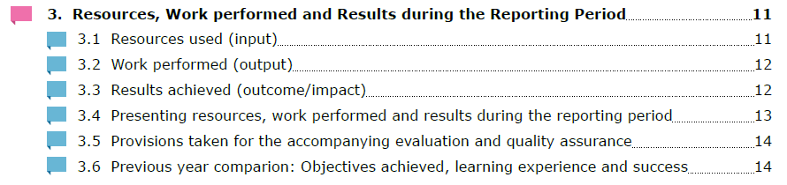
Der Social Reporting Standard (SRS)
Working Session II: Social results

Slide 37
Der Social Reporting Standard (SRS)
Your „Impact Logic“ is complete now – so how did it translate into results in the reporting year?
3.3
3.1
3.2

Slide 38
Der Social Reporting Standard (SRS)
Resources (inputs)
What kind and how much resources are required in order for you to create benefits for your target group?
Financial resources: personnel and material costs including administrative costs
Materials and infrastructure: provided and used materials, space and cars, ...
Time resources: working hours of employees and volunteers
If necessary intangible assets: rights and licenses, knowledge and competences of employees, structural-, human- and relationship capital

Slide 39
Der Social Reporting Standard (SRS)
Achievements (output)
Which and how much individual activities or services do you generate for your target groups?
Brief description of the individual personal performance
How much of this performance was generated last year?
How many people of your target groups were reached last year?
If possible: Time and costs per unit for output (e.g. for a workshop)

Slide 40
Der Social Reporting Standard (SRS)
Results (outcome / impact)
In order to effectively show changes within your target group it is beneficial to identify indicators.
What are indicators?
lat. indicare: to point at something – The first lead for the existence of a certain fact which is not directly observed

Slide 41
4) Your results chain (SRS 3.2 / 3.3)
Organisation
Main
target group
Work performed
(outputs)
Results achieved
(outcome / impacts)
Inputs

Slide 42
Der Social Reporting Standard (SRS)
Indicators
Useable Indicators are „SMART“:
Specific: target a clearly defined area for improvement
Measurable: have the capacity to be counted, observed and analyzed
Achievable: specify the amount of what is to be measured
Relevant: use a relevant data base
Time: specify when the result(s) can be achieved
It is beneficial:
to identify a number of different indicators
to combine quantitative data with qualitative descriptions
to work with comparative figures in order to benchmark the achieved changes (e.g. nation wide recidivism rate)

Slide 43
Der Social Reporting Standard (SRS)
Indicators
Direct
Direct indicators are directly consistent with results.
Indirect or „Proxy“-indicators are used in case of an impracticable direct measurement.
Indirect
Quantitative
Indicators are often quantitative measurements, e.g. expressed as a percentage or as a quotient.
Indicators can also be a qualitative monitoring, e.g. a quotation or a story.
Qualitative

Slide 44
Der Social Reporting Standard (SRS)
Proofs of results
Measurement of the (outcome-) result achievement
Systematic collection and recording through evaluation
Scientifically proven (control groups…)
Direct
proof of results
Recording the demand voiced by the target group or other relevant groups (e.g. recommendations)
Recording and evaluation of the target group‘s feedback (structured and unstructured)
Indirect
proof of results
Assumptions based on personal experiences
Proof of results for comparable activities / concepts
Theory of change – a clear logic model
Logical conclusion

Slide 45
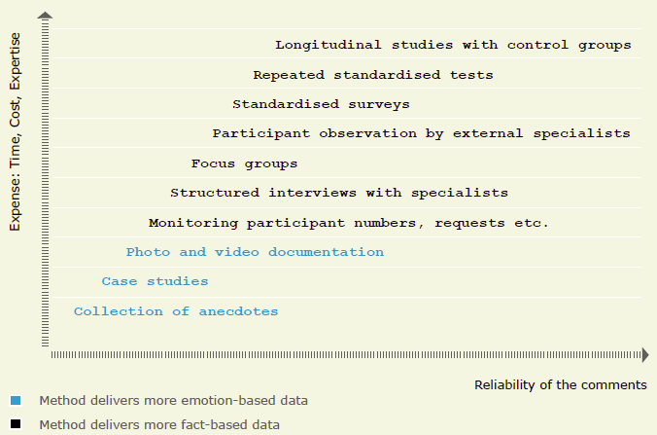
Der Social Reporting Standard (SRS)
Selection of Survey Methods

Slide 46
Der Social Reporting Standard (SRS)
Agenda
Welcome note and round of introduction
Input session
Background and objective of Social Reporting Standard
Result and results chain
Documentation of results within Social Reporting Standard (practical exercise)
Working Session I: The social problem and your solution
Working Session II: Social results
Concluding session and feedback

